Slide 1
Implementation of Daily Pre-Exposure Prophylaxis (PrEP) for MSM and Trans Women:
A Demonstration Study in the Context of Combination HIV Prevention in Brazil, Mexico and Peru
Peru Component
Juan V Guanira, MD, MPH
25/Sep/2018

Slide 2
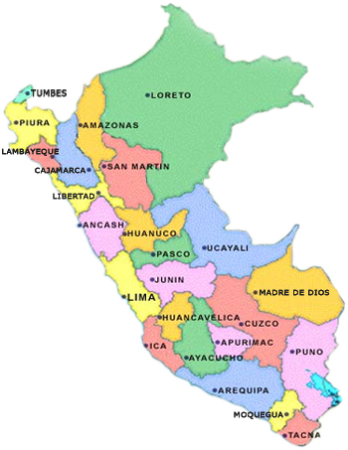
Study Implementation in Peru
Services:
9 Public (CERITS / UAMP)
1 Private in Lima (INMENSA)
Recruitment goal for follow-up: 1500
Recruitment: Mid 2018 –Mid 2019
Follow-up: 1.5-2.5 years (until June 2020)
1 MOH Hospital (Hospital Regional de Trujillo)
2 MOH Hospital (Hospital Amazónico)
1 MOH Hospital (Hospital La Caleta)
1 MOH Centers (San José, Barton, Tahuantinsuyo Bajo, Caja de Agua)
1 Private Center (Inmensa)
2 MOH Hospitals (Hospital Regional de Ica, Hospital San Juan Bautista)

Slide 3
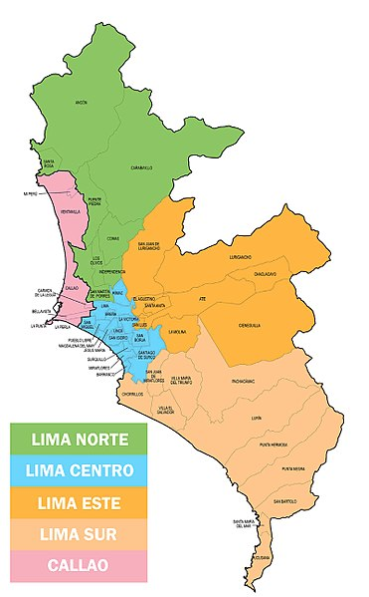
Study Implementation at Lima
Services:
9 Public (CERITS / UAMP)
1 Private in Lima (INMENSA)
Recruitment goal for follow-up: 1500
Recruitment: Mid 2018 –Mid 2019
Follow-up: 1.5-2.5 years (until June 2020)
Comas
San Juan de Luriganco
Callao
Lince
Villa el Salvador

Slide 4
Study Implementation timeline for Peru
Jan/16: Initial Kick-off
Jun/17: approval by UNITAID
Jan/18:ERC/WHO Ethical approval
ERC/WHO Ethical approval
Protocol development
Protocol Implementation
2016
2017
2018
2019
Nov/16:Inicio de conversaciones con DPVIH/MoH
Jun/17: Initial Local IRB approval
Nov_Dec/17: meeting w/regional authorities of sellected sites
Mar/18: ImPrEP Training for Peru
Aug/17: Collaboration Agreement w MoH
Apr-Jul/18: 10 sites training
Jan-Jun/18: logistics for site implementation
Aug-Sep/17:Site assessment Visits to potential sites
May/18: 1st site stared enrolment
Sep/18: last site started enrolment
* DPVIH = Directorate of HIV Prevention

Slide 5
Preparation period
November 2016– January 2018

Slide 6
Potential Benefits for the Country
Strengthening combination prevention strategy
Incorporation of new technologies to the HIV prevention tool-box
Greater potential to address the HIV epidemic in MSM and Trans effectively
Dissemination of the PrEP usage for MSM and Trans
Identification of criteria for efficacious PrEP implementation
Programmatic
Education for health care providers
etc.

Slide 7
Networking and Coalition Building
We worked with the DPVIH at the MoH during study planning stages
Concerns regarding how to include PrEP within existing health services persist
Close communication during preparation, WHO/UNAIDS/PAHO endorsement, and respect for formal processes provided legitimacy to the collaboration
At the organizational and implementation level: three key difficulties were observed:
Very frequent changes in authorities
Lack of interest in the improvement of HIV/STI health services
In some health providers, lack of interest due to absence of additional compensation
Most health facilities demonstrated willingness to collaborate and commitment; understanding ImPrEP as an opportunity to improve services
* DPVIH = Directorate of HIV Prevention

Slide 8
Community Engagement and Demand Creation
Formative research: familiarization with the doubts, myths, and fears about PrEP among both, MSM and TW, communities was fundamental
Additional strategies are needed for TW
Planning: effective coalition building was a critical strategy for project implementation
Preparation for implementation: Community representatives have accompanied the process
Including visiting CBOs near all research sites
Challenges included educating community representatives on PrEP
Work with CBOs must continue to develop critical agents to work toward improved quality of care to facilitate sustained demand for quality PrEP services

Slide 9
Implementation period
February 2018 – September 2018

Slide 10
Implementation Progress (Sept 2018)
Site | Training | Enrollment start | Cummulative Enrolment (Sept 2018) | Target
INMENSA (Lima) | April | May | 16 (16%) | 100
Chimbote | May | June | 23 (18%) | 125
Pucallpa | June | June | 52 (42%) | 100
Barton (Lima) | May | July | 18 (9%) | 200
Tahuantinsuyo Bajo (Lima) | May | July | 25 (13%) | 200
Pisco | May | July | 16 (18%) | 125
San Jose (Lima) | June | August | 9 (5%) | 200
Ica | June | September | 9 (7%) | 125
Caja de Aguas (Lima) | July | September | 5 (3%) | 200
Trujillo | July | September | 9 (7%) | 125
Total |  |  | 182 (12%) | 1500

Slide 11
Logistics for site readiness
Assessment visits and negotiation with potential sites
Site Preparedness: Resolve gaps/issues in:
Equipment
Furniture
Infrastructure and services (e.g. internet access; security)
Staffing (e.g. physicians, lab technicians)
Training
Definition of mechanisms for transportation of supplies/samples:
supply delivery to sites (drugs, tests)
sample collection from sites

Slide 12
Monthly enrolment by site for period May–Sept 2018 & number of site activated

Slide 13
Enrollment progress - Peru

Slide 14
Site by site Progress (Individual Goals)

Slide 15
Implementation Issues in Peru

Slide 16
Health Systems and Preparedness
One significant challenge to PrEP inclusion in HIV/STI prevention services is staffing
These facilities have midwives and nurses, with physicians playing a part-time supervisory role
As only physicians can prescribe PrEP, creative & ad hoc solutions have been needed
Laboratory staffing also varies widely
Some sites have 1 part time technician for all lab procedures (e.g. if this person is absent, no study visits are possible)
HIV prevention facilities have variable autonomy: some are within hospitals while others are independent
Backup equipment, lab QA/QC, & technical assistance are relatively easy in Lima, but not outside of Lima

Slide 17
Many Thanks!
Carlos F. Caceres
Kelika Konda, Juan V Guanira, Gino Calvo (Epidemiology, Clinical, and Coordination)
Ximena Salazar, Aron Núnez-Curto (Qual. Research)
Silver Vargas, Lourdes Ramos, Luz Jazmin Qquellon (Laboratory)
Elizabeth Lugo (Regulatory)
Miguel Lozano (IT)
Oliver Elorreaga (Data Management)
Ximena Gutiérrez, Sonia Flores (Administrative)
Fernando Olivos, Cecilia Ugaz (Communications)
Raul Almonte (Logistics)
Eduardo Juárez, Gaby Mariño (Community Liaison)

